Slide 1
RISC-V Security February 2022

Slide 2
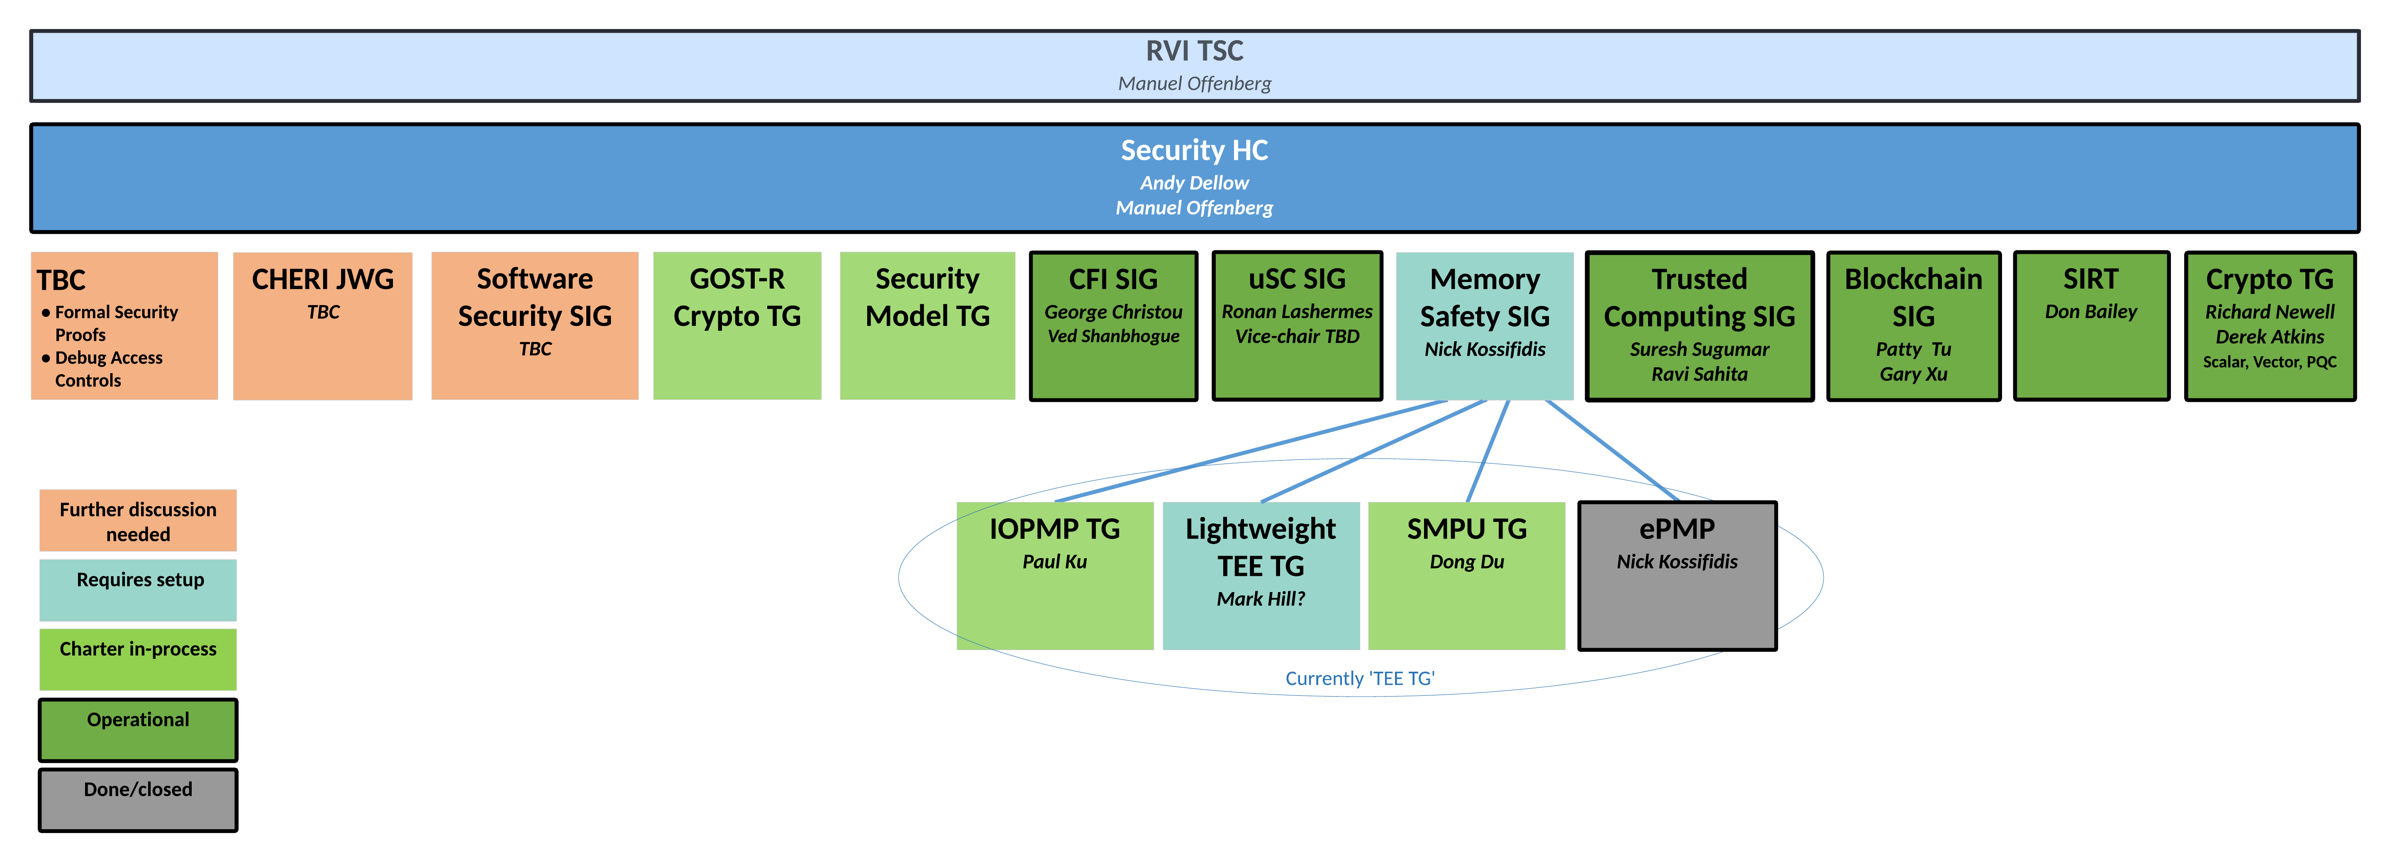
Security HC - Organization

Slide 3
Security HC - Roadmap
Security Incident Response Team
Security Model
Ecosystem, Reference implementations, etc.
Application-TEE, Confidential Compute, and Capabilities-Based
AP-TEE
Cap-Based TEE?
Control Flow Integrity (CFI)
CFI
Blockchain
Scalar Crypto
Vector Crypto
PQC Crypto
GOST-R Scalar Crypto
ePMP
Memory Safety
S-mode MPU
M-mode Isolation?
IOPMP
Pointer Masking (J extension)
Memory Tagging?
Microarchitectural Side Channel (uSC) leakage mitigations
uSC TG(s): Temporal Fencing and others (?)
2021
2022
2023
Sponsored SIG
Sponsored TG
HC work

Slide 4
Planned Specifications
 | CY22-Q1 | CY22-Q2 | CY22-Q3 | CY22-Q4 | CY23-Q1 | CY23-Q2 | CY23-Q3 | CY23-Q4
Security Model (non-ISA)
AP-TEE (ISA + non-ISA)
CFI (ISA)
Vector crypto (ISA)
GOST-R scalar crypto (ISA)
S-mode MPU (ISA)
IOPMP (non-ISA)
uSC leakage (ISA)
Inception
Plan
Develop
Freeze
Rat-Ready
Inception
Plan
Develop
Freeze
Rat-Ready
Inception
Plan
Develop
Freeze
Rat-Ready
Develop
Freeze
Rat-Ready
Inception
Plan
Develop
Freeze
Rat-Ready
Inception
Plan
Develop
Freeze
Rat-Ready
Inception
Plan
Develop
Freeze
Rat-Ready
Inception
Plan
Develop
Freeze

Slide 5
Backup

Slide 6
Intrinsic Security
RISC-V
Process
Standards Compliance, Security Incidence Response
Security Ecosystem
Firmware,
Software, and
Tools
Clean Slate architecture – learn the lessons of the past
Security as a basic feature of hardware, firmware, software
Royalty Free – democratising innovation
Root-of-Trust, Secure Boot
Confidential Computing
Hardware
Security
Capabilities
Trusted Execution Environment
Memory Safety
Crypto Accelleration
Control Flow Integrity
Side Channel Leakage Protection
Embedded
Application
Server
Processor Cores

Slide 7
Security and RISC-V
RISC-V’s open and clean-slate design presents a unique opportunity to re-think security for the next generation of compute infrastructures.
Become foundation for an Intrinsic Security model
Create robustness against malicious code, bugs, exploits
Enabling Trusted Execution and Confidential Computing – with Zero Trust
Secure App
Secure App
App
App
App
Secure System SW + Runtimes
Trusted OS
Rich OS
Secure Hardware Baseline
Trusted Execution Environment Confidential Computing
Crypto Acceleration
Memory isolation, Control Flow Integrity, Side Channel Protection
Hardware Root of Trust, Secure Boot

Slide 8
RISC-V Security 5 year horizon
Platform Security Model outlining RISC-V security capacities and system’s integration
Tools and Software support for RISC-V security capabilities
Protection against side-channel information leakage at the hardware level
Robustness capabilities to prevent malicious manipulation of e.g., code execution flows
Cryptography support for small to large devices, including Post-Quantum Crypto
Memory isolation and Trusted Execution Environments to securely separate applications from each other
Support for Confidential Compute models to enhance application and data privacy
Blockchain technology on RISC-V based systems

Slide 9
Long-Term Priorities
Security Incident Response Team (SIRT) maintenance
Platform Security Model creation
Platform Security Model and RVI Platforms integration
Security functionality competitive / gap analysis
Enhanced cryptography functionality
Microarchitectural side channel leakage mitigations and Control Flow Integrity capabilities
Enhanced memory security model
Define RISC-V architecture for TEEs and Confidential Computing
Security (software) ecosystem enablement
Capability-based solution(s)

Slide 10

Comparison (Work-in-Progress)
Feature |  | arm | intel | AMD
Comprehensive Ecosystem | SBI definition, OPEN SBI Keystone TEE Framework | Standard Security APIs Open Firmware Reference Implementations Security Model | Standard Security APIs Reference Implementations | Standard Security APIs Reference Implementations
Confidential Compute |  | v9A Realms - Confidential Compute Architecture | Intel TDX – Confidential VM Architecture Intel SGX – Confidential Applications Architecture | AMD SEV (-ES, -SNP) - Confidential VM Arch.
Trusted Execution Environment | PMP based TEE, Hypervisor support, S-Mode MPU (no isolation at m-mode) | Trustzone A/M class HW TEE | Intel TXT, Intel VT-x | AMD SVM
System-level Security | IOPMP | Trustzone A/M class HW TEE V9A Realms | Intel TDX | AMD SEV
Arbitrary Privileged Code Execution | ePMP, NX/SMAP/SMEP | Privilege Access Never | NX/SMAP/SMEP | XD/SMAP/SMEP
Memory Safety | ePMP | Memory Tagging Extension | ?? | ??
Control Flow Integrity |  | Branch Target Identifier Pointer Authentication Code | Indirect Branch Tracking Shadow Stack | Shadow Stack
Microarch. Side Channels |  | Speculation Barriers | Speculation Barriers | Speculation Barriers
Cryptography | AES, SHA2, SM3, SM4, entropy, Data Independent Execution Latency | AES, SHA2, SHA3, SM3, SM4, RNG, Vector | AES, SHA, RNG, AVX-512 | AES, SHA, RNG, AVX2
Crypto library |  | AArch64cryptolib | Intel IPP Cryptography | AMD Optimizing CPU Libraries
Trusted Computing SIG
Memory Safety SIG
CFI SIG
uArch Side Channel SIG
Crypto TG
Notes:
Intel SGX depreciated on PC class CPUs: https://github.com/intel/linux-sgx/issues/760#issuecomment-999258032

